Slide 1
A time simulated annealing-back propagation algorithm(TSA-BP) and its application in disease prediction Published August 2018 in World Scientific journal
Uğur Ceylan

Slide 2
Content
Introduction
Neural Network(NN) and Back Propagation(BP)
TSA-BP Algorithm
Materials -Data- and Their Tests
Comparision with Other Algorithms
Conclusion

Slide 3
Introduction
The proposed algorithm(TSA-BP) can improve the convergence rate and numerical stability. By using this proposed algorithm, the learning rates and initial weights in the BP neural network could be easily adjusted.
Several numerical experiments have been tested by using different disease data. Furthermore, we compared the TSA-BP algorithm to the other existing, well-known algorithms. Numerical results show higher accuracy and eciency of the TSA-BP algorithm.

Slide 4
NN
The performance of one NN algorithm is evaluated by the accuracy rate of prediction and training time.
Despite various kinds of NN approaches, achieving both high accuracy of prediction and less training time is still challenging.
Most algorithms which claim to have high accuracy usually require high training time.

Slide 5
NN Fields
Enhancing the performance of the NN algorithm is the main goal in different research fields.
In the field of medical applications, multiple approaches/algorithms, such as articial intelligence and machine learning techniques, have been used for disease prediction.
Research data shows that NN algorithms provide both accurate and efficient methods to solve disease prediction problems.
The ANN model demonstrated 94.2% variability in breast cancer prediction.

Slide 6
NN with BP
In 1986, Rumelhart et al.19 presented the idea of using the Back Propagation (BP) to solve the NN problems efficiently. Now, the BP algorithm can be applied to a wide range of problems because it can solve complicated random nonlinear mapping issues(adjusting the model’s parameters (weights and biases)).
Zhang et al.22 diagnosed congenital heart disease and colorectal cancer based on BP NN and obtained 75% diagnostic accuracy.
However, the slow convergence rate and poor numerical stability of traditional BP algorithm are always disturbing, and the training time will become lengthy as the sample size increases.
They aim to develop some prediction algorithms that have better performance than most existing state- of-the-art algorithms in different characteristics.

Slide 7
TSA-BP Algorithm
They normalized the data by using the min-max standardized algorithm to ensure the range of data is between 0 and 1. By normalizing, they avoided the limitations of slow convergence and the high amount of training time for the inconsistency of data unit.
Then they selected the BP algorithm to optimize the NN model.
They could respectively process the hidden layer and the output layer by using different activation functions. As This algorithm uses the hyperbolic tangent S function for the hidden layer and the general linear function for the output layer.
They introduce the cross-entropy cost function such as the energy function (which is the objective function).

Slide 8
TSA-BP Algorithm – Cont..
They further introduce the simulated annealing algorithm to implement the weight adjustment and the inversion phase after optimizing the structure of the NN model by using the BP algorithm.
In general, the traditional NN algorithms usually use the gradient descent method (GDM). However, the GDM often leads to a local optimal solution instead of the global one.
This combination of the SA and BP algorithms enabled us to receive the new values based on a specific probability. Therefore, we were able to produce the optimal solution with the minimum error. The TSA-BP method can avoid falling into the local minimum.
At the same time, we did not need to need the inverse of the large matrix which is an expensive operation.
Therefore, the proposed algorithm has advantages in terms of simplifying codes, controlling objective functions flexibly and acquiring the global optimal solutions.

Slide 9
TSA-BP Algorithm Initialization
The weight matrix of the NN is set as w;
The minimum error accuracy is e;
The initialized parameters are set as:
the current iteration time m = 1,
the counter LocalCount = 0,
the learning rate = 0,1;
E(m) is the sum of squared errors of the mth iteration in the network
SA(w) is the SA algorithm.

Slide 10

TSA-BP Algorithm Steps
Step-1: Initialize the weight matrix; avoid the limitations of slow convergence and high training time by using the min-max standardized algorithm
where X is the training dataset, N represents the normalized result matrix, Xi(max) and Xi(min), respectively, denote the maximum and minimum of the ith property in X

Slide 11
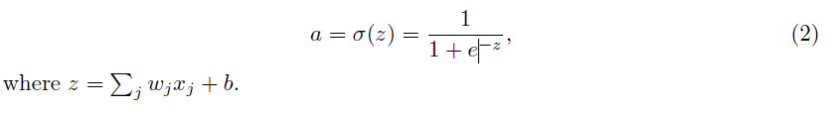
TSA-BP Algorithm Steps – Cont..
Step-2: Set the input as x1, x2,.., the weight values as w1, w2,.., the bias as b, and the output of neuron as
Step-3:Define the cross-entropy cost function C of a neuron as
where n is the total number of samples, y is the expected output and a is the predicted output of a neuron.

Slide 12
TSA-BP Algorithm Steps – Cont..
Step-4: Define the hyperbolic tangent S function as the activation function
Step-5: Calculate E(m) in the training network based on BP algorithm. If E(m) < e, the condition of convergence is satisfied, then proceed to the Step-11.
Step-6: Compare the equation E(m)-E(m-1); adjust the learning rate according to the activation function f(z).

Slide 13
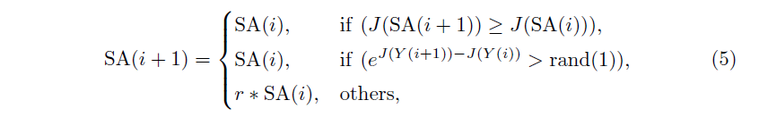
TSA-BP Algorithm Steps – Cont..
Step-7: If |E(m) - E(m-1)j|< p, where p is a selected threshold, increase the parameter LocalCount = LocalCount + 1; otherwise, set LocalCount = 0.
Step-8: If LocalCount > C, the NN has fallen into the local minimum, then record the error at this time. Make the local minimum LocalMin = E(m) by using the SA algorithm
where r = rand(1), rand(n) is a nxn random matrix; the value range of every element is (0,1).

Slide 14
TSA-BP Algorithm Steps – Cont..
Step-9: If E(m) < e, the condition of convergence is satisfied again, then proceed to Step 11.
Step-10: If E(m) < LocalMin, this algorithm jumps out of the local minimum, then begin another iteration of BP training. Otherwise, return to Step-7.
Step-11: Stop the network training.

Slide 15
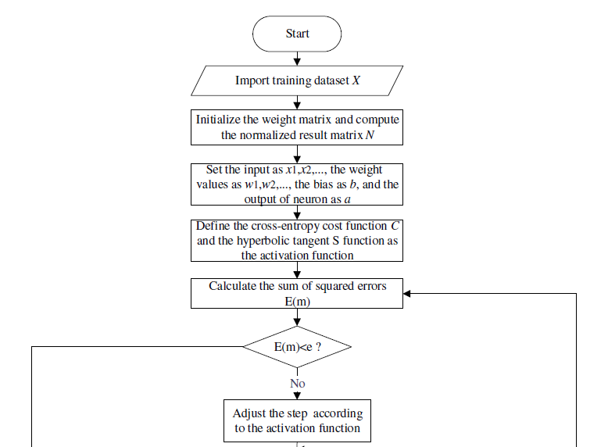
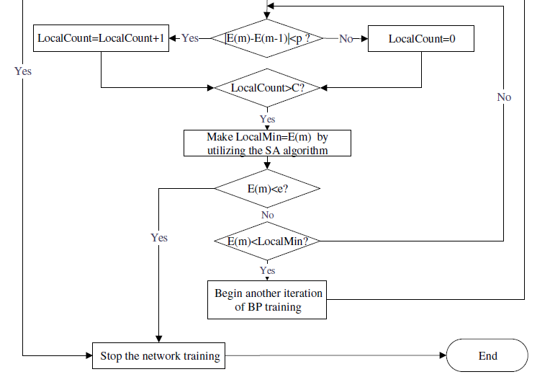

Slide 16
TSA-BP Algorithm - Complexity
Based on the steps of this algorithm, one of the most significant key factors of the BP algorithm is the capacity of the constructed network Xm*n, which will be close to
Xn*m >= (n + 1)H, if there is only one output node and the computational complexity is approximately O(e[(n+1)H]), where n is the number of samples, m is the number of the properties of samples, and H is the number of hidden nodes.
According to the SA algorithm, the time complexity of one internal loop is O(n) and the external loop is O(m). Thus, the total time complexity is O(n*m).

Slide 17
TSA-BP Algorithm – Complexity – Cont’
Similarly, the space complexity of one internal loop is O(n) with consideration to the external loop. Therefore, the total space complexity is O(n*n). The time complexity of TSA-BP is O(n*m). Considering the space complexity, the internal complexity is O(m) and the external is O(n), the total space complexity of TSA-BP then is O(n*n).

Slide 18
Simulations and Analysis
To verify the accuracy and efficiency of the TSA-BP algorithm, they test it by using three types of disease networks: breast cancer network, coronary heart disease network, and adult disease network. We also compared the TSA-BP algorithm to the other popular algorithms.

Slide 19
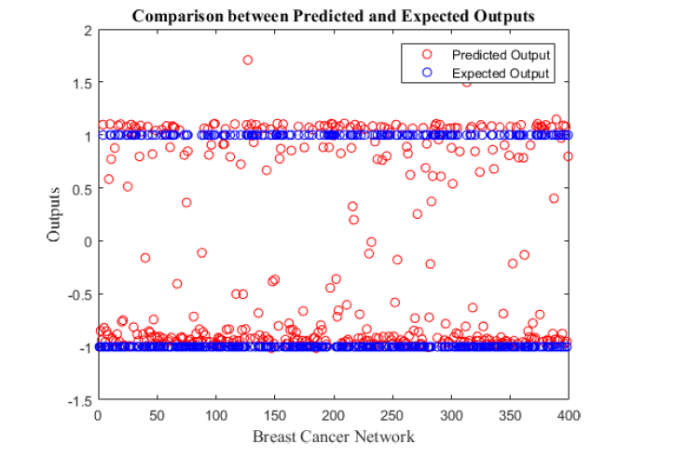
Test on the breast cancer network
Dataset with 32 properties. This dataset contains 459,347 records.
300 cases of training data and 400 cases of testing data.
Training time is 92, accuracy is 0.9361
benign tumor vs. malignant tumor.

Slide 20
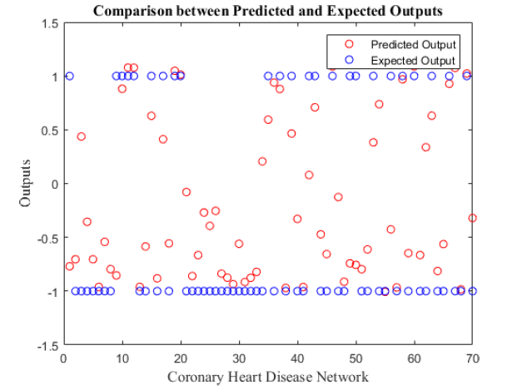
Test on the coronary heart disease network
11 properties, 270 records.
200 cases of training data and 70 cases of testing data.
Sickness vs. non-sickness
Training time : 16, accuracy : 0.6615.

Slide 21
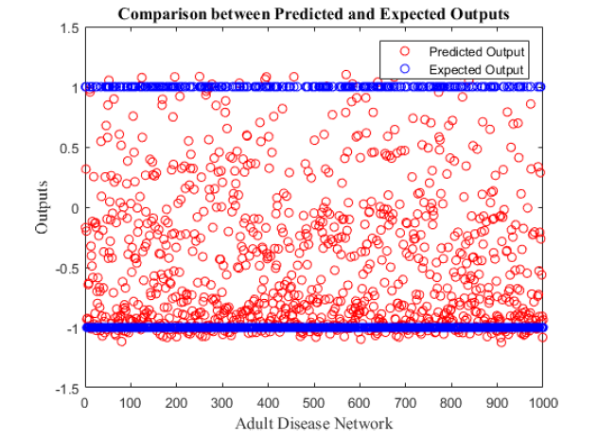
Test on the adult disease network
14 properties, 5000 records
4,000 cases of training and 1,000 cases of testing
sickness vs. non-sickness.
training time : 71, accuracy – 0.5717

Slide 22
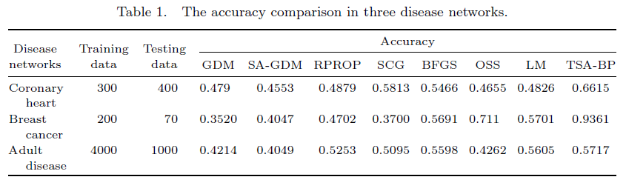
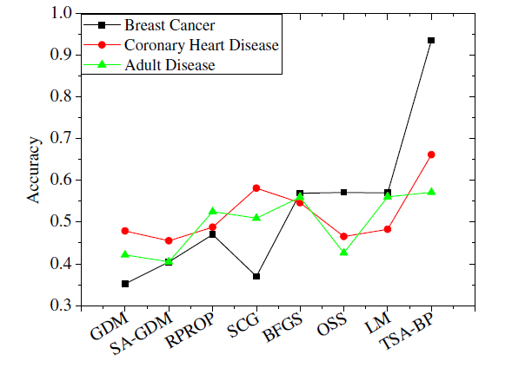
Simulation results and contrastive analysis
Contrastive analysis of accuracy:

Slide 23
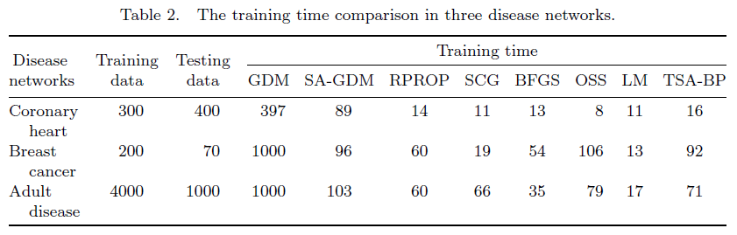
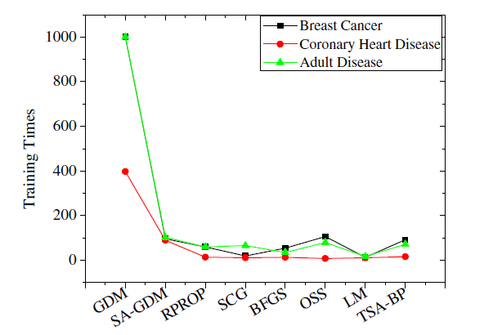
Simulation results and contrastive analysis – Cont..
Contrastive analysis of training time

Slide 24
Conclusions
In this paper, based on the BP algorithm, we designed a new NN algorithm TSA-BP. We optimized this algorithm by using the SA algorithm to improve the weight adjustment and the inversion phase.
The proposed TSA-BP algorithm enables better performance regarding accuracy rate and training time.
We have tested the TSA-BP algorithm in multiple datasets to observe the accuracy and the training time.

Slide 25
Conclusions – Cont..
All three experiments show high accuracy rates and efficiency of the TSA-BP algorithm
Furthermore, we compared the proposed algorithm to current popular algorithms such as GDM, SA-GDM, RPROP, SCG, BFGS, OSS, and LM.
The experimental results prove that the TSA-BP algorithm could produce fewer errors than most available algorithms, and it also reduces the amount of training time according to the GDM and OSS algorithms.

